Slide 1

URXperience Vlog 2
By The 4 Codesmen - Abraham, Dhruv, Dinesh, Favor
ENSE 400/477(2022-2023): SSE Capstone

Slide 2
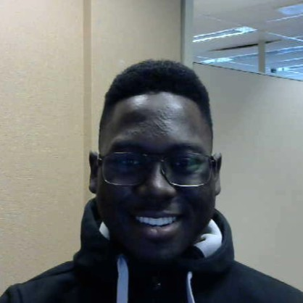
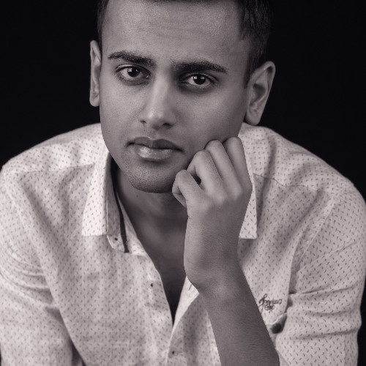
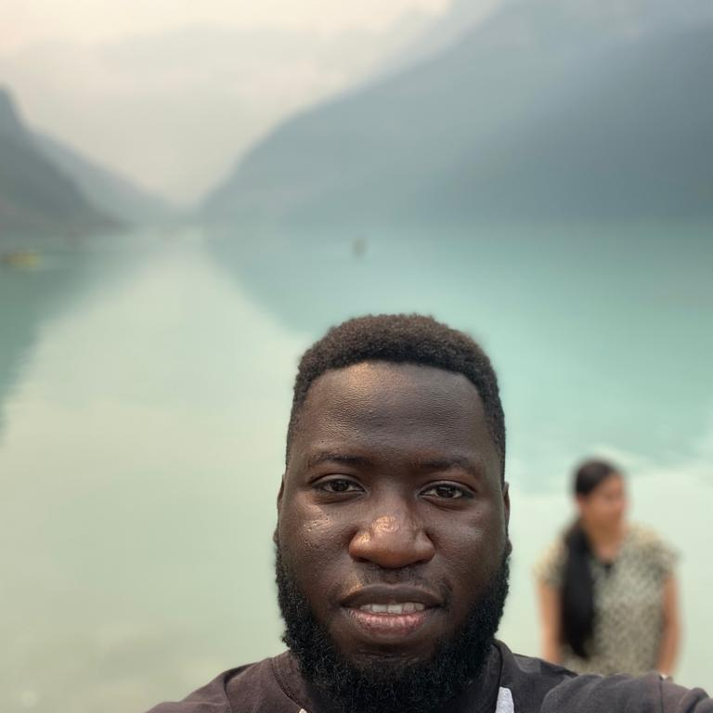
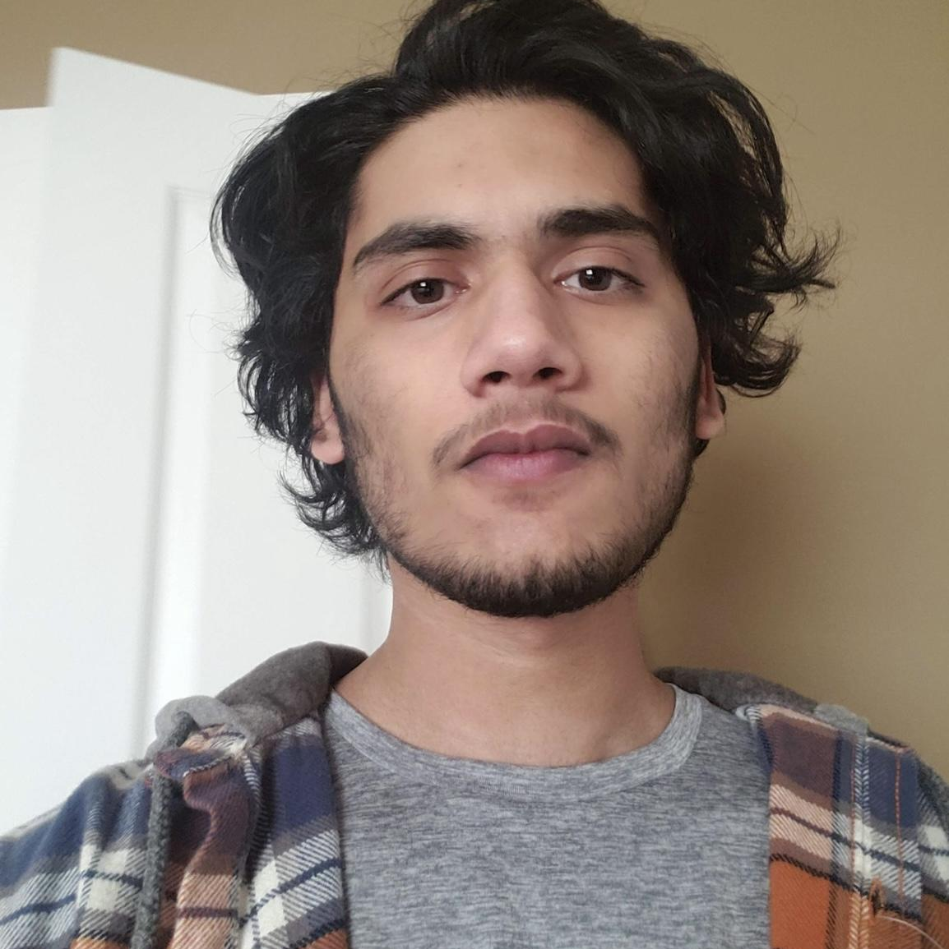
Team (Re)Introduction
Favor Fasunwon Frontend Developer and UI/UX Designer
Dhruv Modi Team Lead and Backend Developer
Abraham Mugerwa Frontend Developer Documentation Manager
Dinesh Dalip Software Architect and Backend Developer

Slide 3
Project background & business need/opportunity
For our capstone project we are building a web application for U of R residence that allows U of R Residence Students:
To connect with each other
Make friends
Help each other out academically [Build a community]
Be part of the Residence life [Stay updated about events]
To decrease/eliminate the social gap [Less isolation and increased socialization]
Current Situation
Currently U of R Residence does not have a dynamic application that brings U of R Students together. There is an application for U of R Residence however it is outdated and requires a major upgrade.
Opportunity
Build an application for U of R residence that
Replaces the old application
Enhances the experience of living on campus
Future Opportunity
Go beyond U of R and share this digital ecosystem with other University Residences as well.

Slide 4
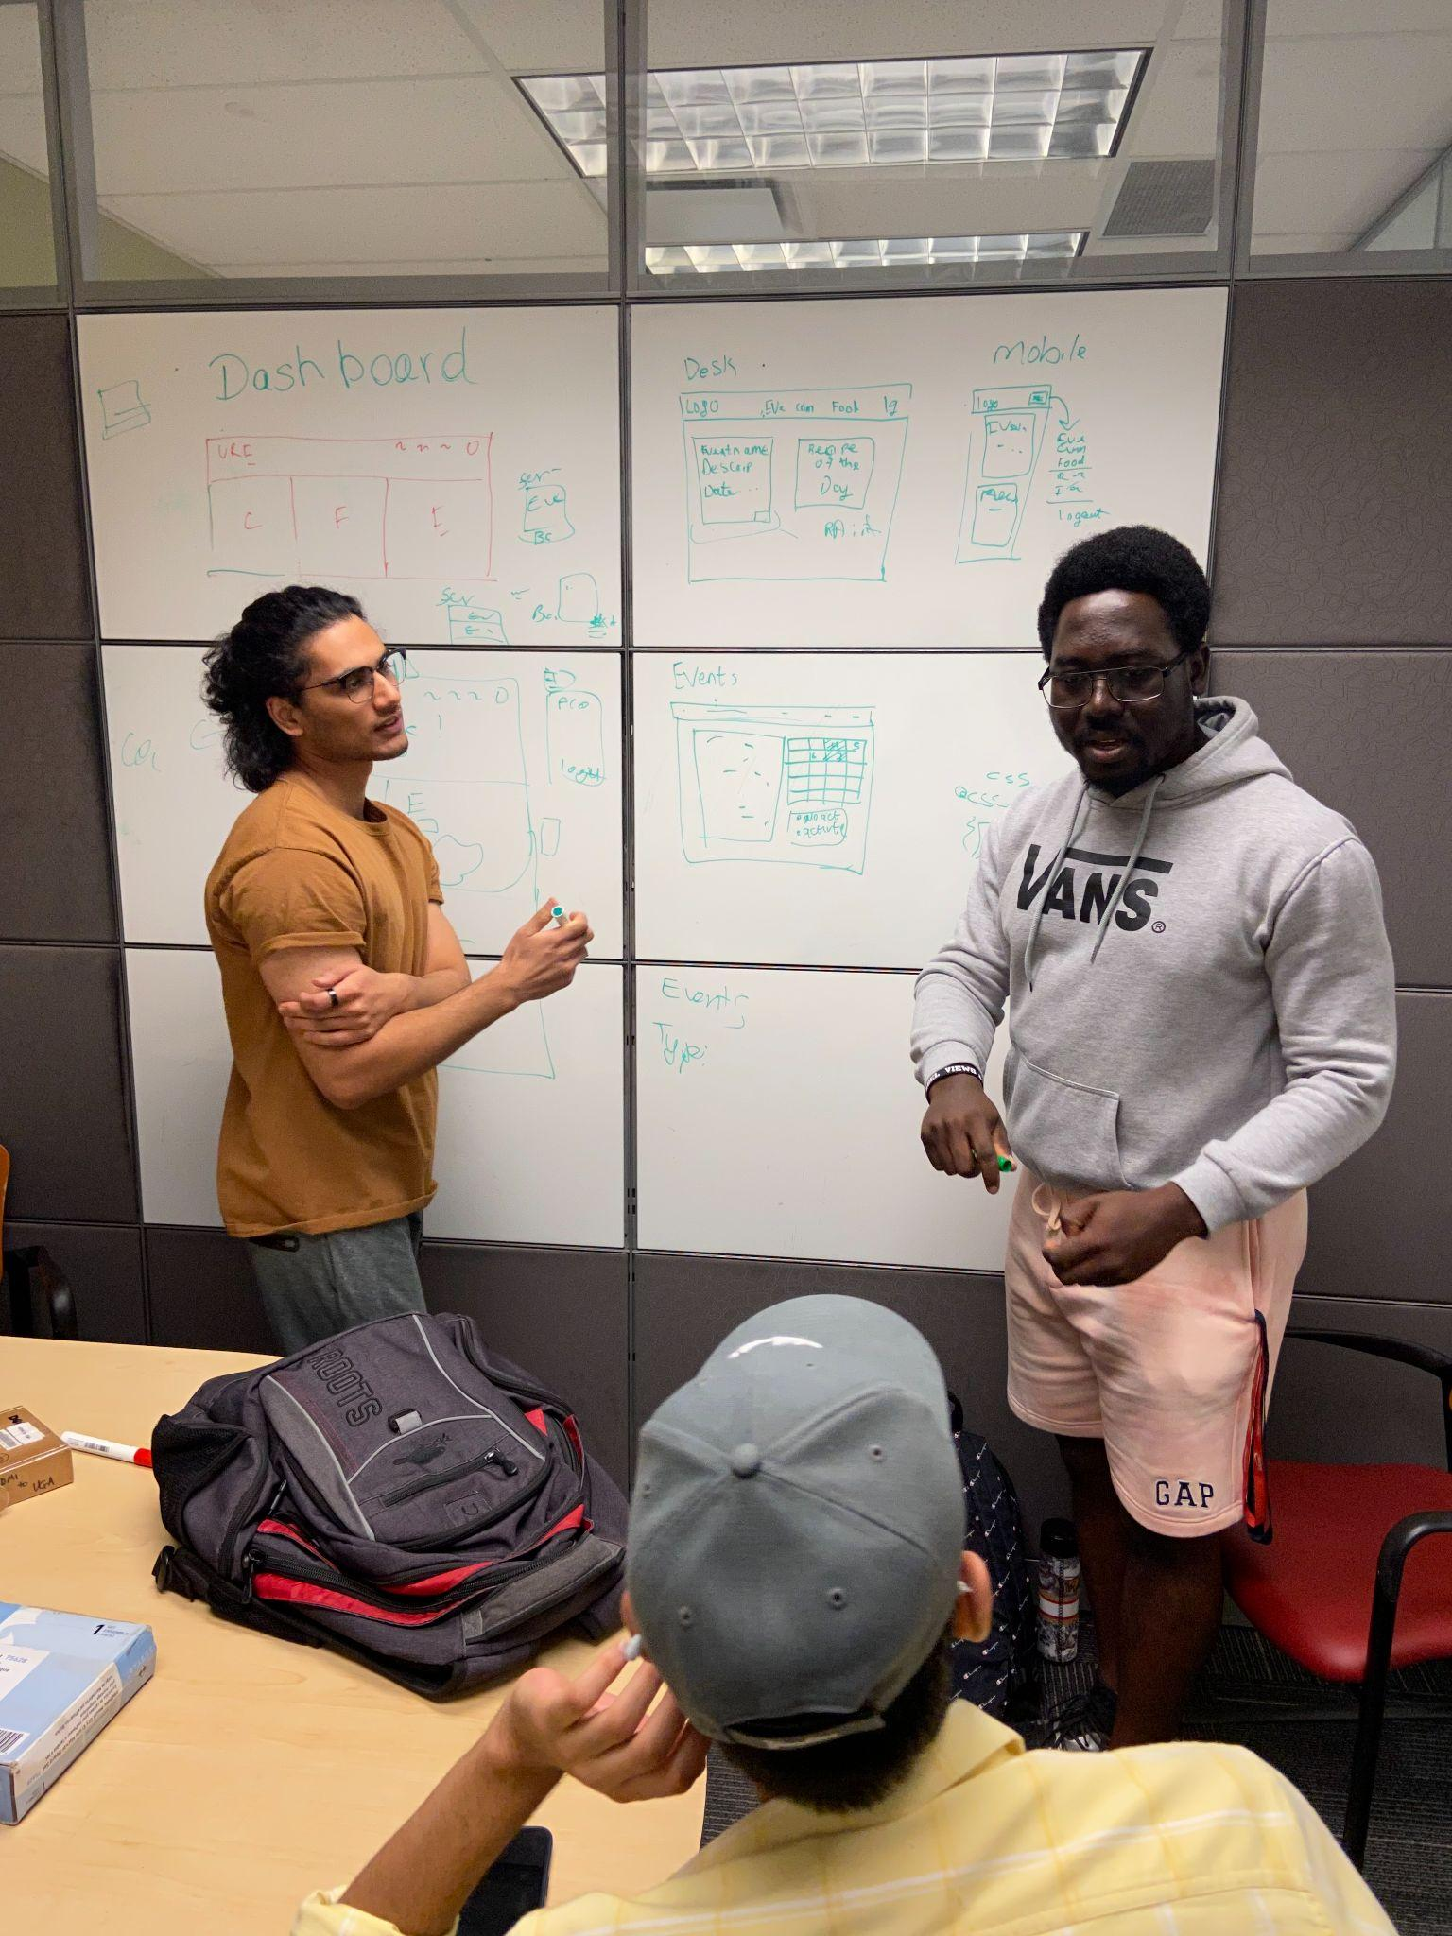
Status Description
Green
We believe we are still in the Green zone as we confirmed/validated our tech stack, completed our application diagramming through lofis, hifis, class diagrams and user story maps, and we have our front and back end setup to begin the building phase of our application with utilization of MVC design pattern.
Responsibilities during previous 2 weeks
Team: we worked on the final lofi diagram, the scrum 2 presentation, and meeting with Bryan (Manager of UR residence) and Craig (Mentor).
Dhruv: Lo-Fi prototype, Set up meeting with Craig, Use Case Diagram,Scrum 2 Powerpoint
Abraham: Lo-Fi prototype, Hi-Fi prototype with Favor
Dinesh: Lo-Fi prototype, Use Case Diagram, Class Diagram for main features, layout of the database schema, Found APIs, User Story Map with Favor refreshed knowledge about MERN stack.
Favor: Emailed Byran regarding our application and a potential comparison of our app and theirs. Lo-Fi prototype. Hi-Fi prototype with Abraham as well as testing it with a previous residence attendee (User Testing). Studied React and Node Js via youtube tutorials and courses. Implemented the login functionality for code base setup (front and back end). User Story Maps with Dinesh.

Slide 5
Project Changes/Issues
Changes
Minor changes to Lo-fi
Issues
Minor issue with hifi prototype application(Mockitt)
Only able to make mobile version (However our application is built to be responsive for both desktop and mobile)
Only one person could edit (for free)

Slide 6
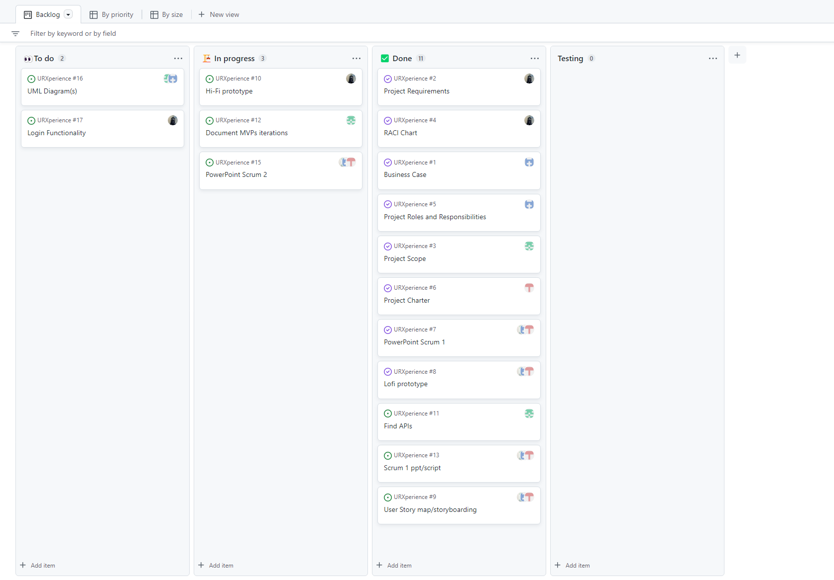
KanBan Board
This board illustrates how we plan for the 2-week interval towards the next scrum. It also keeps us organized in distribution of responsibilities
Desktop

Slide 7
Hi-Fi Prototype
The Hi-Fi Prototype illustrates the web application in a mobile responsive state
Mobile

Slide 8
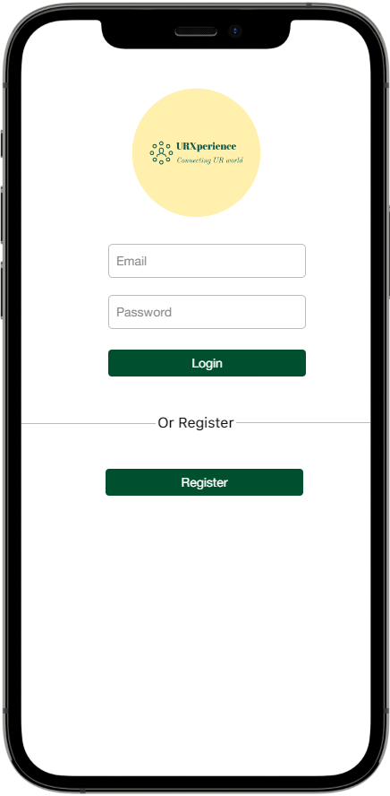
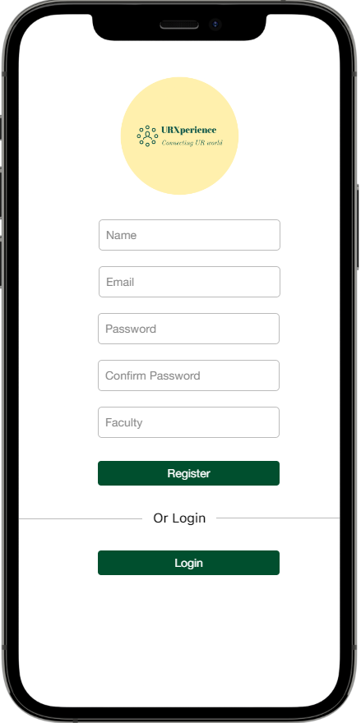
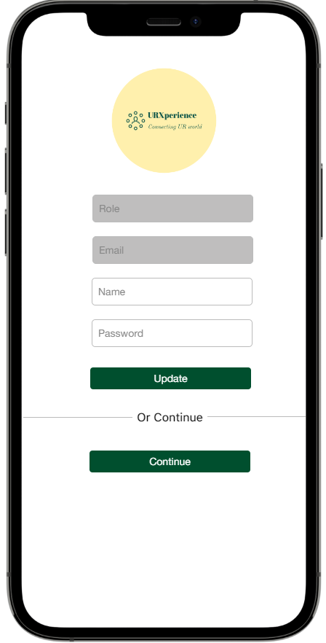

Slide 9
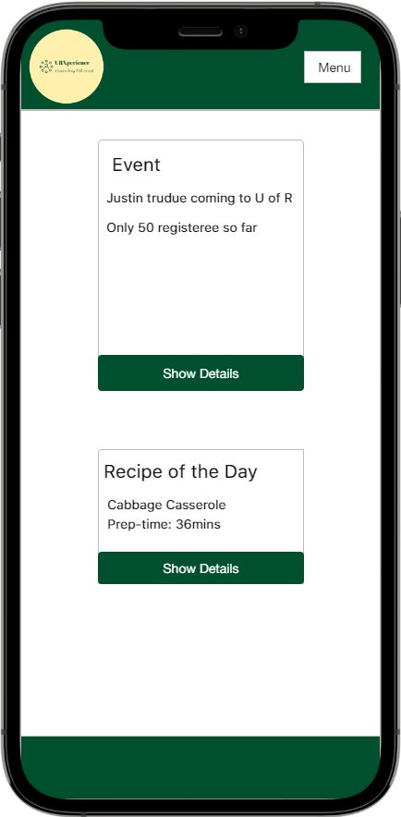
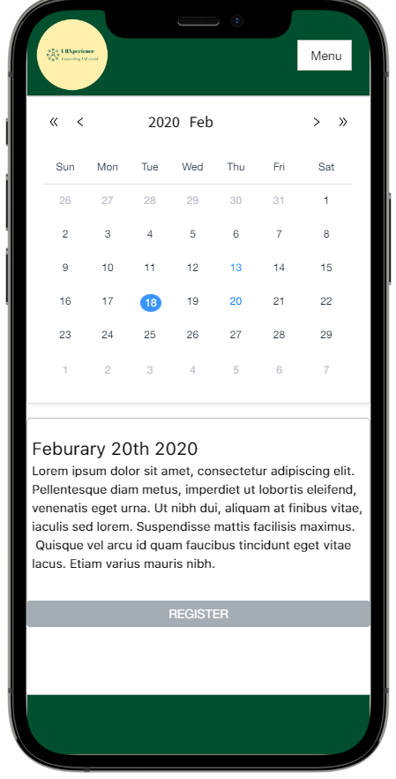
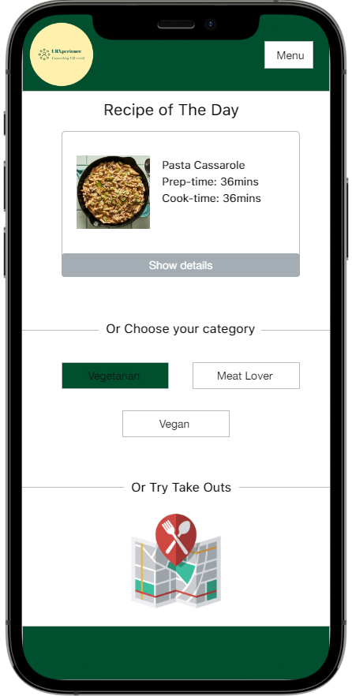

Slide 10
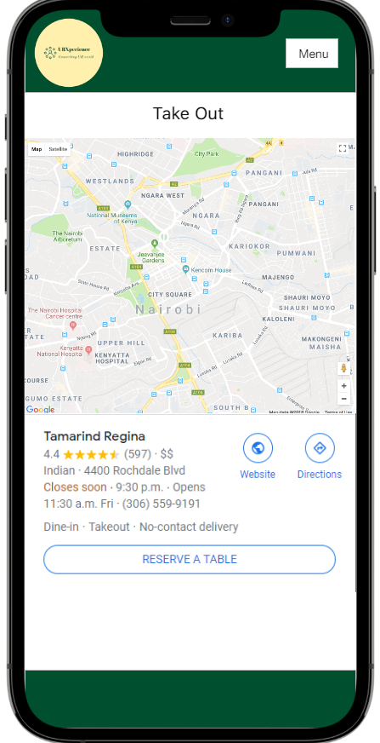
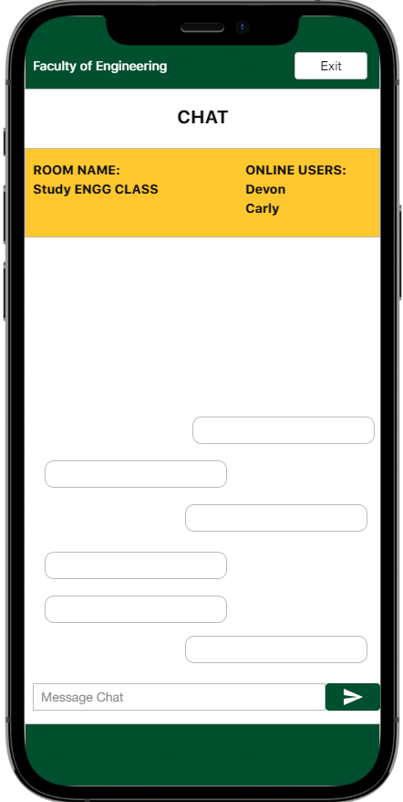

Slide 11

Login DEMO

Slide 12
Next Up
Team:
Decide on distribution of technical responsibilities and coding workflow
Finish the food and community feature of the application
Dhruv & Dinesh:
Individually research MERN (NodeJs, MongoDB) backend and API Integration
Work on completing the backend coding for food feature and community feature for our application (Controller, Model)
Gantt Chart (Dinesh)
Abraham & Favor:
Individually research more on frontend framework (React of the MERN stack) with course and tutorials
Work on completing frontend of food and Community feature of the application (View)

Slide 13
Team Reflection
Does the team feel "on track"? (reiterate the above colour status)
We feel we’ve accomplished the steps required prior to starting our MVP 1 and we feel confident and ready to start developing our app
What progress does the team particularly feel good (great) about?
Collaboration has gone well, and prototypes were decided as a team
What barriers (if any) does the team feel are a current impediment to success?
Pending feedback from RA manager on his potential issues with the project
What help (if any) does the team require to move positively forward?
Technical help from our mentor and professors if possible
What questions or concerns does the team have (if any)?
What is the outcome(s) of not meeting the MVP1 by december?

Slide 14
THANKS!
Any questions?

Slide 15
CREDITS
Special thanks to all the people who made and released these awesome resources for free:
Presentation template by SlidesCarnival
Photographs by Unsplash

